Slide 1
Estimating NHL Player Contract Value
Alquzi, Britton, Falkowski, Napolitano

Slide 2
Agenda
Hypothesis & Inspiration
Data Sources & Preprocessing
Resulting Dataframe
Model Pipeline Construction
Initial Model Evaluation
Model Engineering
Final Model Evaluation
Real World Application
Shortcomings
Segregation of Duties

Slide 3
Hypothesis & Inspiration
Recent developments in ice hockey “advanced analytics” are changing the way players are valued.
Can we use some publicly available metrics to try our hand at salary cap management?

Slide 4
Transformation Methodology
ContractData.xlsx
PuckPedia.com
PerformanceData.xlsx
PuckPedia.com
Training Set
Modelling
Results

Slide 5
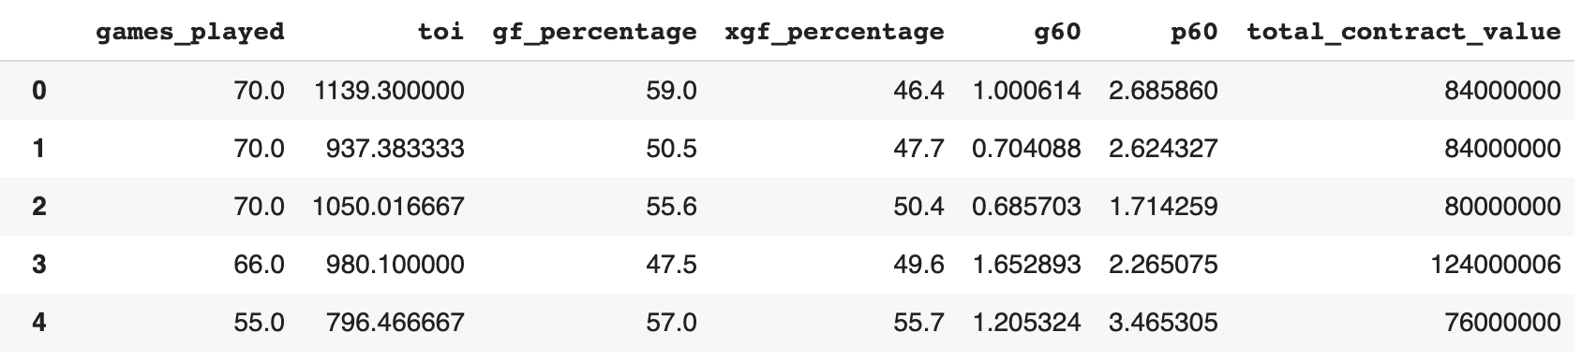
Resulting Dataframe
Independent variables
Dependent variable

Slide 6
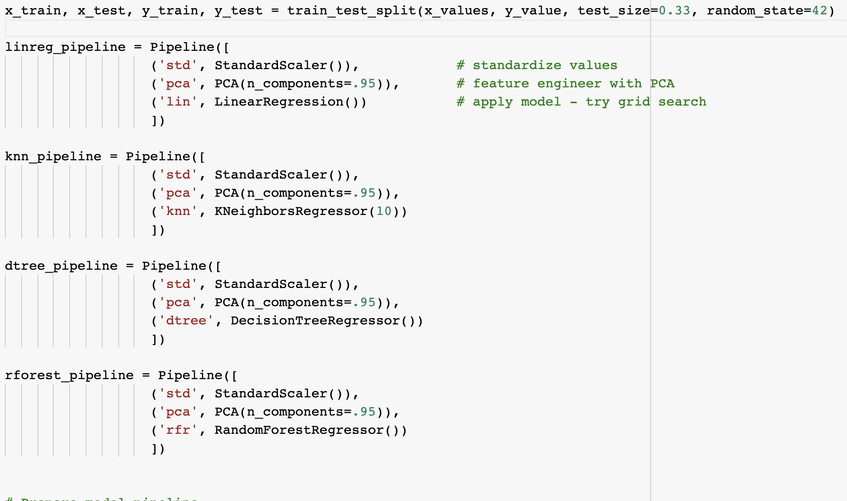
Model Pipeline Construction

Slide 7
Initial Model Evaluation
Our team decided to deploy the following 4 continuous regressor models
 | Linear Regression | K Nearest Neighbors Regressor | Decision Tree Regressor | Random Forest Regressor
R Squared | -2.7 | 0.00 | 0.84 | 0.83
Root Mean Squared Error | $18,838,431 | $16,046,579 | $8,578,353 | $8,717,198
Mean Absolute Error | $13,197,552 | $10,643,630 | $4,020,705 | $4,461,048

Slide 8
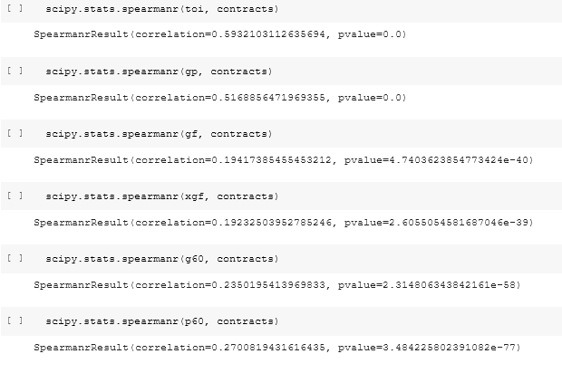
Model Engineering
As we compiled our initial prediction, we wanted to delve deeper into the training components and find out which data points provided the most “weight”. We started by performing the Spearman function out of scipy.stats on each component and the y-value, total contract value.

Slide 9
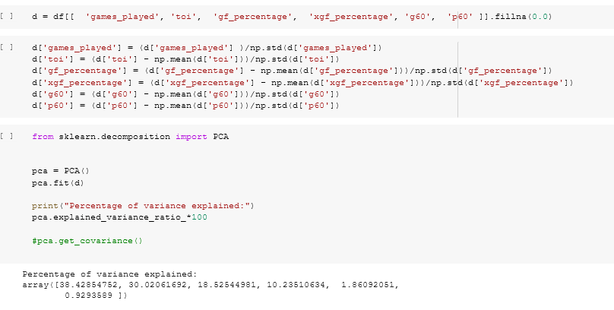
Model Engineering
We then decided to perform a principal component analysis to confirm that games played and time on ice held the most “weight” in our predictions. We standardized the data and performed the PCA to see how much each component contributed to the total variance.

Slide 10
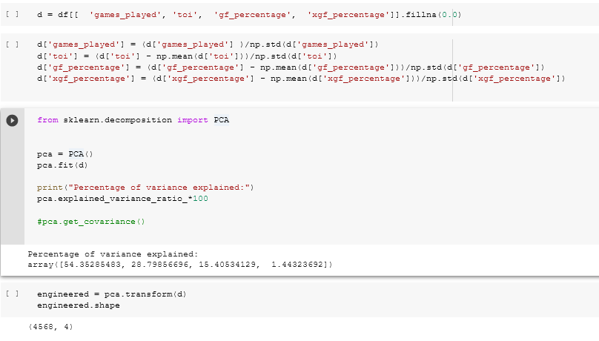
Model Engineering
After performing the analysis, we decided to remove g60 and p60 from the original training set and further transformed the data before re-running our models again.

Slide 11
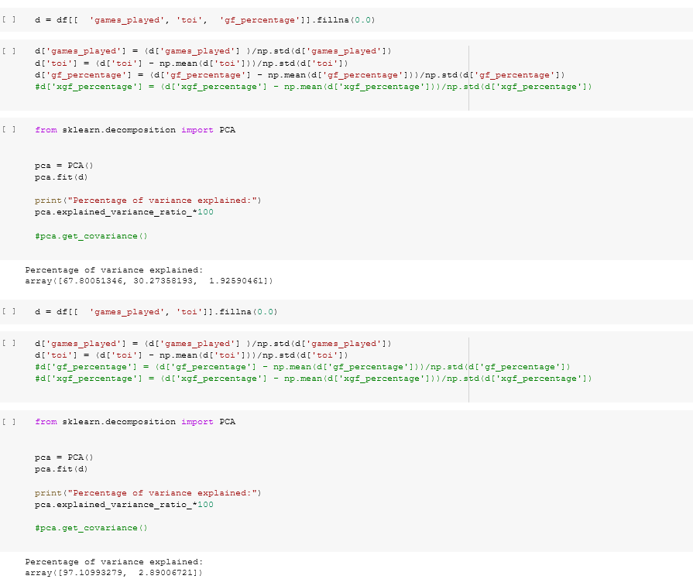
Model Engineering
After re-running the models, we continued to reduce the dimensionality of the training set to confirm the most dominant components.

Slide 12
Final Model Evaluation
The Linear Regression and KNN models saw largest improvements from model optimization efforts
 | Linear Regression | K Nearest Neighbors Regressor | Decision Tree Regressor | Random Forest Regressor
R Squared | -1.84 (↑32%) | 0.61 (↑61 points) | 0.84 | 0.82
Root Mean Squared Error | $18,944,190.1 | $11,617,350 (↓28%) | $8,668,192.2 | $8,744,676.6
Mean Absolute Error | $13,237,335.2 | $7,543,667 (↓29%) | $4,041,678.7 | $4,627,060

Slide 13
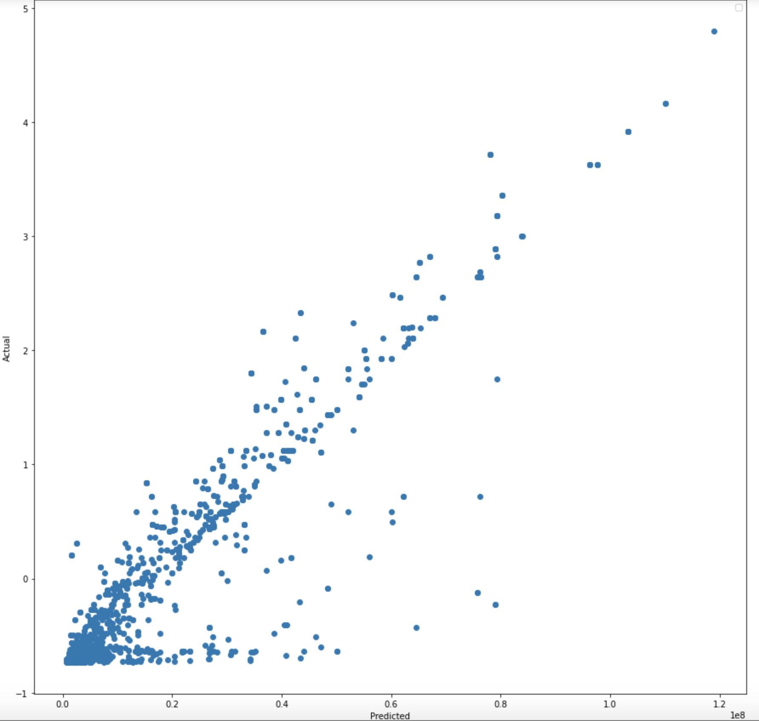
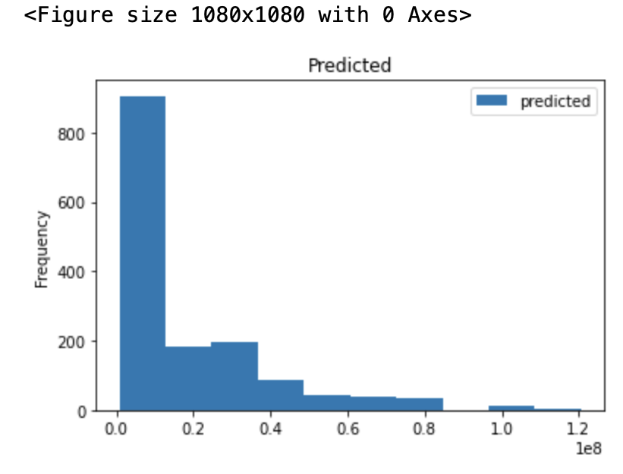
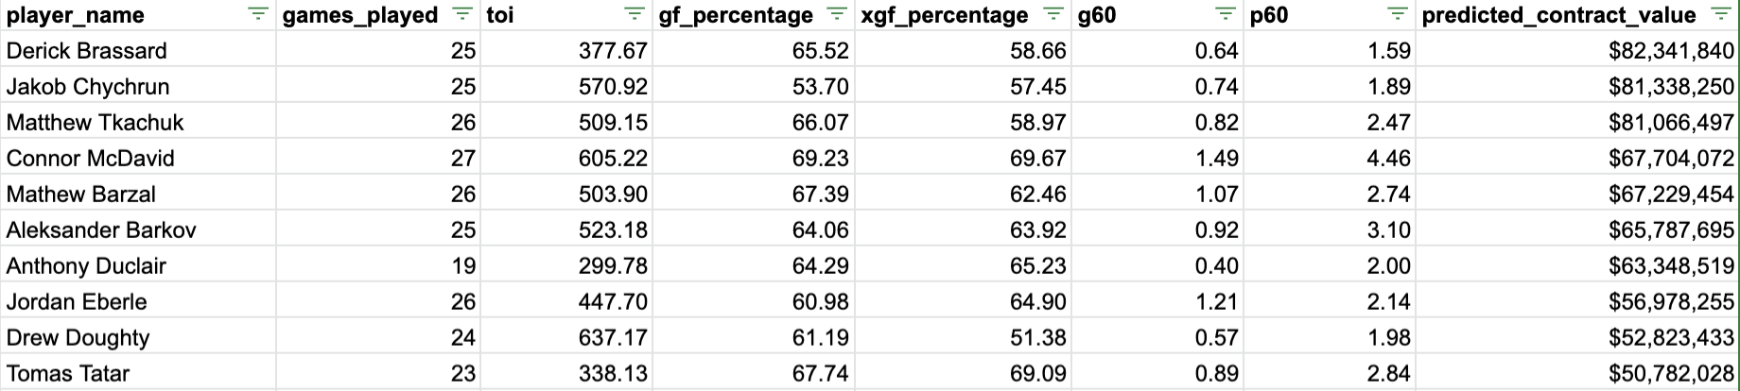
Random Forest Model Results

Slide 14
Segregation of Duties
Aziz Alquzi
Model engineering, model evaluation
Wynton Britton
Model engineering & performance optimization
Evan Falkowski
Model engineering
Andrew Napolitano
Data retrieval, model preparation, and storytelling

Slide 15
Thank you
Questions welcome!

